Slide 1
Custom Scaling on Kubernetes
Much of the code comes from:
https://github.com/stefanprodan/k8s-prom-hpa

Slide 2
Gateway Service
Posts to the booking service
Gets from the booking service or the airmiles service
There is also a config file which
import json import socket from nameko.rpc import RpcProxy from nameko.web.handlers import http class GatewayService: name = 'gateway' bookings_rpc = RpcProxy('bookings_service') airmiles_rpc = RpcProxy('airmiles_service') #Test function @http('GET', '/') def test (self, request): return "success!" @http('GET', '/booking/<string:name>') def get_airport(self, request, name): trip = self.bookings_rpc.get(name) return json.dumps({'trip': trip}) @http('POST', '/booking') def post_airport(self, request): data = json.loads(request.get_data(as_text=True)) success = self.bookings_rpc.create(data["name"], data['from_airport'], data['to_airport']) return success @http('GET', '/miles/<string:name>') def get_trip(self, request, name): miles = self.airmiles_rpc.get(name) return miles

Slide 3
Bookings Service
The booking service create() function receives messages from the Gateway service and stores the information in a redis database.
It sends a message to the airmiles service to assign a certain amount of miles to the name associated with the booking created.
The bookings service uses the Prometheus client to count the number of times the create() function is called. This metric is assigned the name: “requests_total” and is exported to port 8000 to be scraped by Prometheus.
Prometheus Client: https://github.com/prometheus/client_python
from nameko.rpc import rpc from nameko_redis import Redis import json from nameko.rpc import RpcProxy from prometheus_client import start_http_server, Counter c = Counter('requests_total', 'Total number of post requests') class BookingsService: name = "bookings_service" redis = Redis("bookings_db") airmiles_rpc = RpcProxy('airmiles_service') start_http_server(8000) @rpc def get(self, name): airports = self.redis.get(name) return airports @rpc def create(self, name, from_airport, to_airport): global c c.inc() self.redis.set(name, json.dumps({ "from": from_airport, "to": to_airport })) miles = self.airmiles_rpc.create(name) return "trip created and " + miles + " miles added to account"

Slide 4
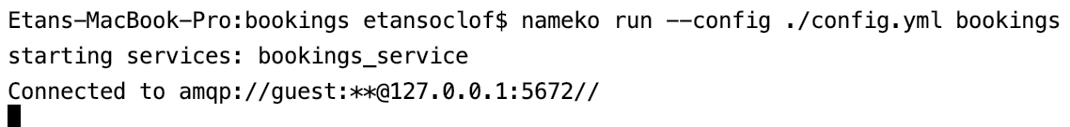
Presenting the Custom Metric
We can run this service locally to show the Prometheus metric being exported.

Slide 5
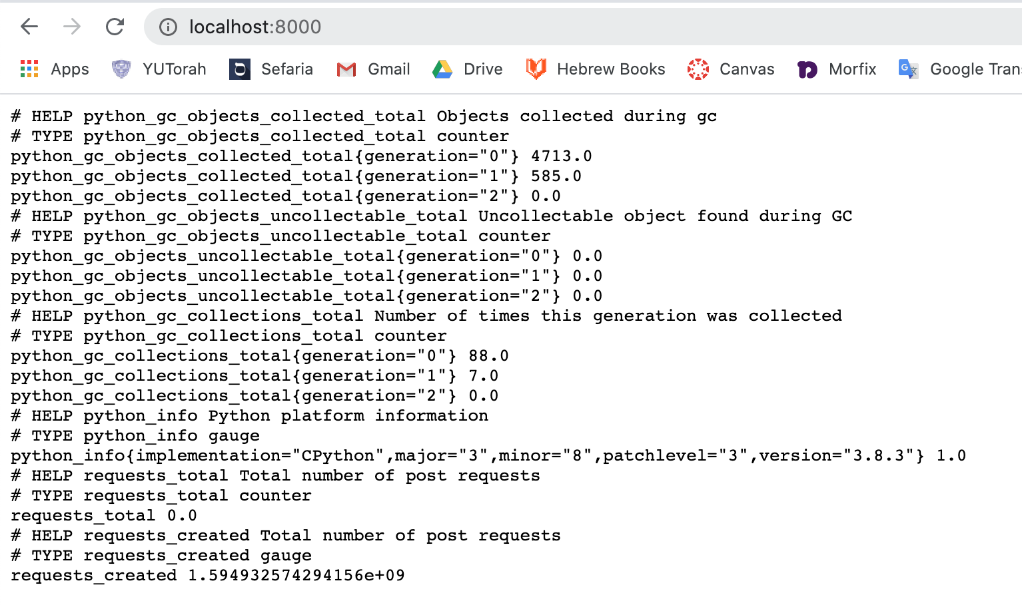
If we go to http://localhost:8000, we can see that the metric is being served. The function has not been called so the value is 0.
This data can be read by Prometheus

Slide 6
Airmiles Service
The airmiles service receives a message from the bookings service and assigns a random amount of miles to the given name. This data is stored in a redis database.
There is also a get() function which can be called via the gateway service to get the amount of miles associate with a name.
import random from nameko.rpc import rpc from nameko_redis import Redis class AirmilesService: name = "airmiles_service" redis = Redis('airmiles_db') @rpc def get(self, name): miles = self.redis.get(name) return miles @rpc def create(self, name): miles = random.randint(50, 1000) self.redis.set(name, str(miles)) return str(miles)

Slide 7
Basic Architecture
Post Request
Gateway
Redis db
Bookings
Airmiles
Redis db

Slide 8
Deploy Rabbitmq deployment (messaging service) to Kubernetes
apiVersion: v1 kind: Service metadata: annotations: kompose.cmd: kompose convert kompose.version: 1.21.0 () creationTimestamp: null labels: io.kompose.service: rabbit name: rabbit spec: ports: - name: "5672" port: 5672 targetPort: 5672 selector: io.kompose.service: rabbit status: loadBalancer: {} --- apiVersion: apps/v1 kind: Deployment metadata: annotations: kompose.cmd: kompose convert kompose.version: 1.21.0 () creationTimestamp: null labels: io.kompose.service: rabbit name: rabbit spec: replicas: 1 selector: matchLabels: io.kompose.service: rabbit strategy: {} template: metadata: annotations: kompose.cmd: kompose convert kompose.version: 1.21.0 () creationTimestamp: null labels: io.kompose.service: rabbit spec: containers: - image: rabbitmq:3-management imagePullPolicy: "" name: rabbit ports: - containerPort: 5672 resources: {} restartPolicy: Always serviceAccountName: "" volumes: null status: {}
This deployment runs a rabbitmq docker image on port 5762. The rabbit Kubernetes service provides access to port 5762.
For a good tutorial on rabbitmq and nameko, see https://www.toptal.com/python/introduction-python-microservices-nameko

Slide 9
Deploy Redis Deployement to Kubernetes
This deployment runs a redis docker image on port 6379. The redis Kubernetes service provides access to port 6379.
--- apiVersion: v1 kind: Service metadata: name: redis labels: app: redis role: master tier: backend spec: ports: - port: 6379 targetPort: 6379 selector: app: redis role: master tier: backend --- apiVersion: apps/v1 # for versions before 1.9.0 use apps/v1beta2 kind: Deployment metadata: name: redis labels: app: redis spec: selector: matchLabels: app: redis role: master tier: backend replicas: 1 template: metadata: labels: app: redis role: master tier: backend spec: containers: - name: master image: k8s.gcr.io/redis:e2e # or just image: redis resources: requests: cpu: 100m memory: 100Mi ports: - containerPort: 6379 ---

Slide 10
Deploy Gateway Service
apiVersion: v1 kind: Service metadata: annotations: kompose.cmd: kompose convert kompose.version: 1.21.0 () creationTimestamp: null labels: io.kompose.service: gateway name: gateway spec: ports: - name: "8000" port: 8000 targetPort: 8000 selector: io.kompose.service: gateway type: LoadBalancer --- apiVersion: apps/v1 kind: Deployment metadata: annotations: kompose.cmd: kompose convert kompose.version: 1.21.0 () creationTimestamp: null labels: io.kompose.service: gateway name: gateway spec: replicas: 1 selector: matchLabels: io.kompose.service: gateway strategy: {} template: metadata: annotations: kompose.cmd: kompose convert kompose.version: 1.21.0 () creationTimestamp: null labels: io.kompose.service: gateway spec: containers: - env: - name: RABBIT_HOST value: rabbit - name: RABBIT_PASSWORD value: guest - name: RABBIT_PORT value: "5672" - name: RABBIT_USER value: guest image: etansoclof/gateway:1.01 imagePullPolicy: "" name: gateway ports: - containerPort: 8000 resources: {} restartPolicy: Always serviceAccountName: "" volumes: null status: {} ---
This deployment runs a Gateway docker image on port 8000. The Gateway Kubernetes service provides access to port 8000.

Slide 11
Deploy Bookings Deployment
apiVersion: apps/v1 kind: Deployment metadata: annotations: kompose.cmd: kompose convert kompose.version: 1.21.0 () creationTimestamp: null labels: io.kompose.service: bookings name: bookings spec: replicas: 1 selector: matchLabels: io.kompose.service: bookings strategy: {} template: metadata: annotations: kompose.cmd: kompose convert kompose.version: 1.21.0 () prometheus.io/scrape: "true" # must be quoted prometheus.io/port: "8000" # must be quoted prometheus.io/path: "/" creationTimestamp: null labels: io.kompose.service: bookings spec: containers: - env: - name: RABBIT_HOST value: rabbit - name: RABBIT_PASSWORD value: guest - name: RABBIT_PORT value: "5672" - name: RABBIT_USER value: guest - name: REDIS_HOST value: redis - name: REDIS_PORT value: "6379" image: etansoclof/bookings:metric4 imagePullPolicy: "" name: bookings resources: {} restartPolicy: Always serviceAccountName: "" volumes: null status: {}
This yaml file deploys the Bookings deployment and service. Remember that the bookings service is exporting the Prometheus metric on port 8000. Under annotations, specifications are made so that Prometheus scrapes the deployment at port 8000.

Slide 12
Deploy Airmiles Deployment
This yaml file deploys the airmiles deployment.
apiVersion: apps/v1 kind: Deployment metadata: annotations: kompose.cmd: kompose convert kompose.version: 1.21.0 () creationTimestamp: null labels: io.kompose.service: airmiles name: airmiles spec: replicas: 1 selector: matchLabels: io.kompose.service: airmiles strategy: {} template: metadata: annotations: kompose.cmd: kompose convert kompose.version: 1.21.0 () creationTimestamp: null labels: io.kompose.service: airmiles spec: containers: - env: - name: RABBIT_HOST value: rabbit - name: RABBIT_PASSWORD value: guest - name: RABBIT_PORT value: "5672" - name: RABBIT_USER value: guest - name: REDIS_HOST value: redis - name: REDIS_PORT value: "6379" image: etansoclof/airmiles:1.01 imagePullPolicy: "" name: airmiles resources: requests: cpu: "10m" limits: cpu: "200m" restartPolicy: Always serviceAccountName: "" volumes: null status: {}

Slide 13
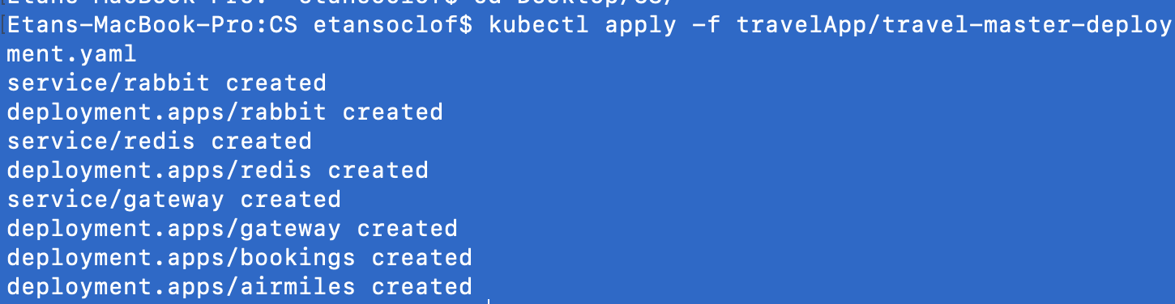
Kubectl
All the above deployments can be applied using one kubectl command:
kubectl apply -f travel-master-deployment.yaml

Slide 14
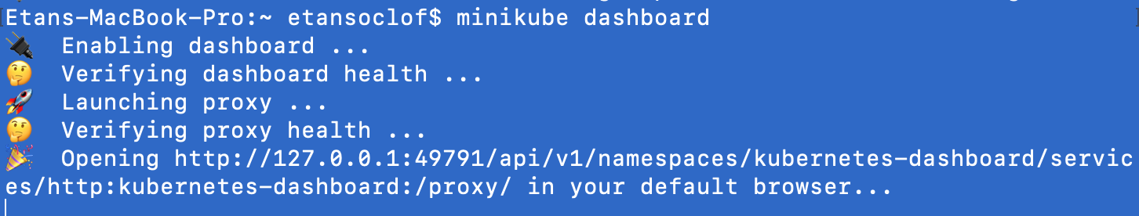
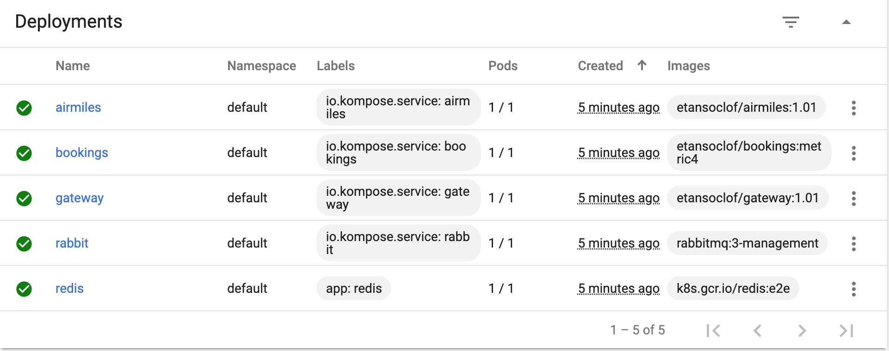
Using the Kuberenetes dashboard
The Dashboard should open in your default browser. You should see the various deployments already deployed:

Slide 15
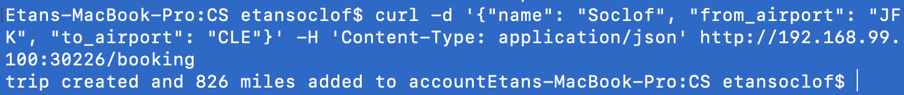
Test
To test, let’s send a post request to the gateway service. To get the IP address to send to, use this command:
minikube service --url gateway
Send a post request to that IP address

Slide 16
Deploy Prometheus
Create Monitoring namespace to house the Prometheus components:
--- apiVersion: v1 kind: Namespace metadata: name: monitoring

Slide 17
Prometheus Deployment
This is the Prometheus deployment. It has two config maps linked to it which will be defined in the next slides.
--- apiVersion: apps/v1 kind: Deployment metadata: name: prometheus namespace: monitoring spec: replicas: 1 selector: matchLabels: app: prometheus template: metadata: labels: app: prometheus annotations: prometheus.io/scrape: 'false' spec: serviceAccountName: prometheus containers: - name: prometheus image: prom/prometheus:v2.1.0 imagePullPolicy: Always command: - prometheus - --config.file=/etc/prometheus/prometheus.yml - --storage.tsdb.retention=1h ports: - containerPort: 9090 protocol: TCP resources: limits: memory: 2Gi volumeMounts: - mountPath: /etc/prometheus/prometheus.yml name: prometheus-config subPath: prometheus.yml - mountPath: /etc/prometheus/rules.yml name: rules-config subPath: rules.yml volumes: - name: prometheus-config configMap: name: prometheus-config items: - key: prometheus.yml path: prometheus.yml mode: 0644 - name: rules-config configMap: name: rules-config items: - key: rules.yml path: rules.yml mode: 0644

Slide 18
Prometheus config-map
The Prometheus config map defines the frequency of the scraping (in our case, every second) and which Kubernetes resources should be scraped. It also is linked to a rules config which can be used to create custom metrics. (This is not the entire config-map; only the part I understand).
global: scrape_interval: 1s scrape_timeout: 1s evaluation_interval: 1s rule_files: - rules.yml scrape_configs: - job_name: 'kubernetes-apiservers'

Slide 19
The Rules Config
To create our own metrics, we will use a rules config which combines standard metrics to create new metrics.
kind: ConfigMap apiVersion: v1 metadata: labels: app: prometheus name: rules-config namespace: monitoring data: rules.yml: | groups: - name: custom_rule rules: - record: requests_per_second expr: sum(rate(requests_total[2s])) labels: namespace: default deployment: bookings
This rules configurations creates a custom rule. It takes the requests_total metric exposed by the bookings deployment, and calculates the amount of requests per second over a 2 second period. (So if there were 10 requests made in 2 seconds, the metric will equal 5 requests per second).
The metric is associated with the bookings deployment in the default namespace and we have labeled it as such.

Slide 20
RBAC
An RBAC yaml, which provides permissions for Prometheus must also be deployed, as well as a Prometheus service.

Slide 21
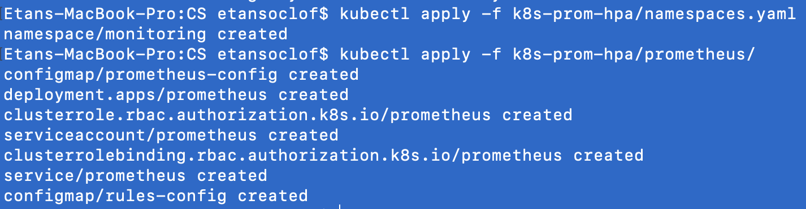
Kubectl Prometheus
All the above can be deployed using two kubectl commands:
kubectl apply -f k8s-prom-hpa/namespaces.yaml
kubectl apply -f k8s-prom-hpa/prometheus/

Slide 22
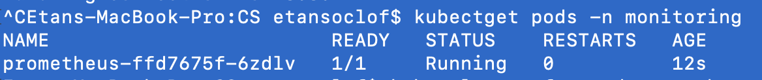
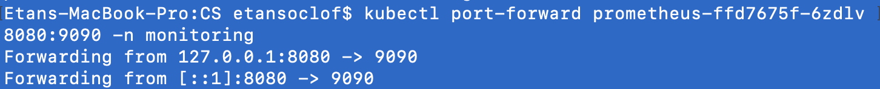
Check to see that Prometheus is working
Check to see that the promethus pod is running:
Kubectl get pods –n monitoring
Set up the Prometheus Dshboard using the name of the pod returned from the above command:
kubectl port-forward prometheus-ffd7675f-6zdlv 8080:9090 -n monitoring

Slide 23
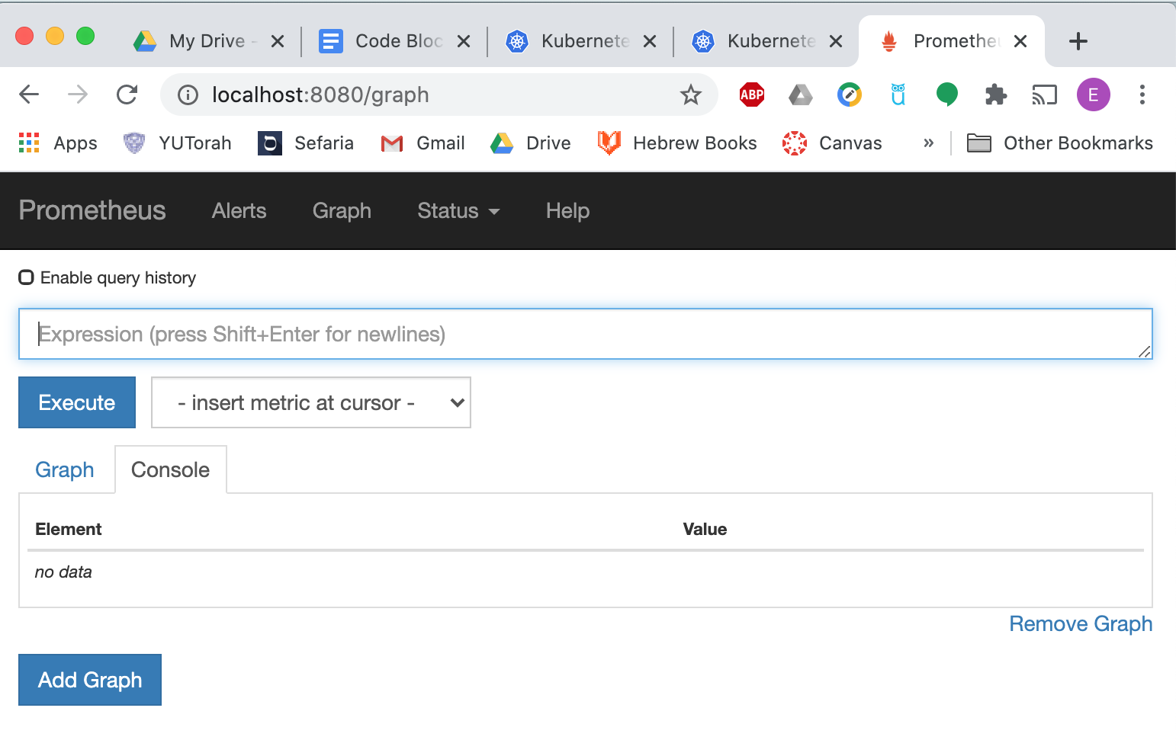
Prometheus Dashboard
Open the Prometheus dashboard in your browser on http://localhost:8080/

Slide 24
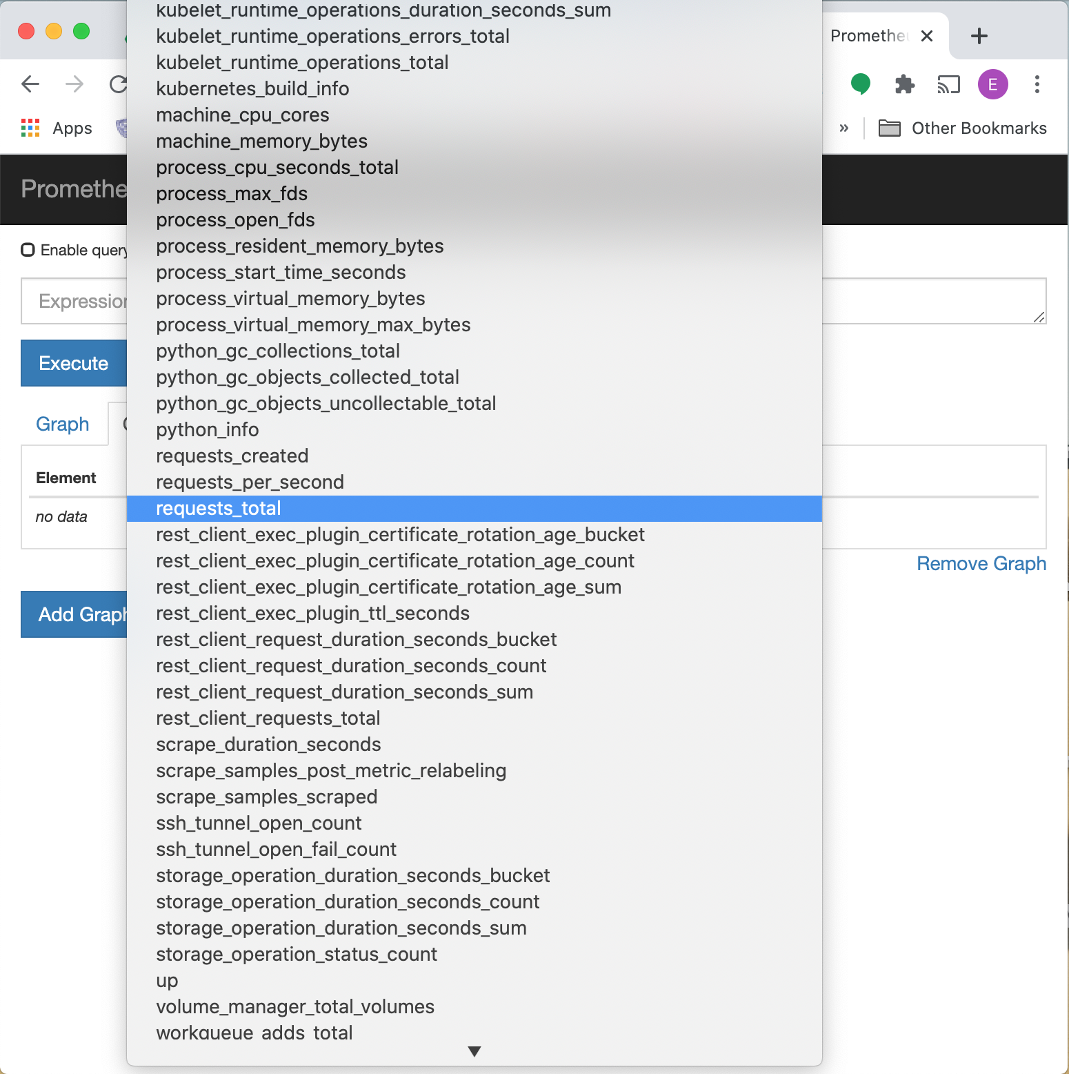
You should be able to find the two metrics that we have defined in the drop down menu:
Requests_total (exposed by the bookings deployments)
Requests_per_second (defines in the rules.cfg)

Slide 25
Prometheus Kubernetes API Adapter
In order for our autoscaler to use the metrics provided by Prometheus, it must be integrated into the Kubernetes Custom Metrics API. To do this we create an adapter deployment. We must edit the configuration file to include our custom metric. We add the following request (see https://github.com/DirectXMan12/k8s-prometheus-adapter for details):
- seriesQuery: 'requests_per_second{deployment!=\"\",namespace!=\"\"}' resources: overrides: namespace: resource: \"namespace\" deployment: resource: \"deployment\" name: matches: ^(.*) as: \"${1}\" metricsQuery: requests_per_second{deployment=\"bookings\",namespace=\"default\"}

Slide 26
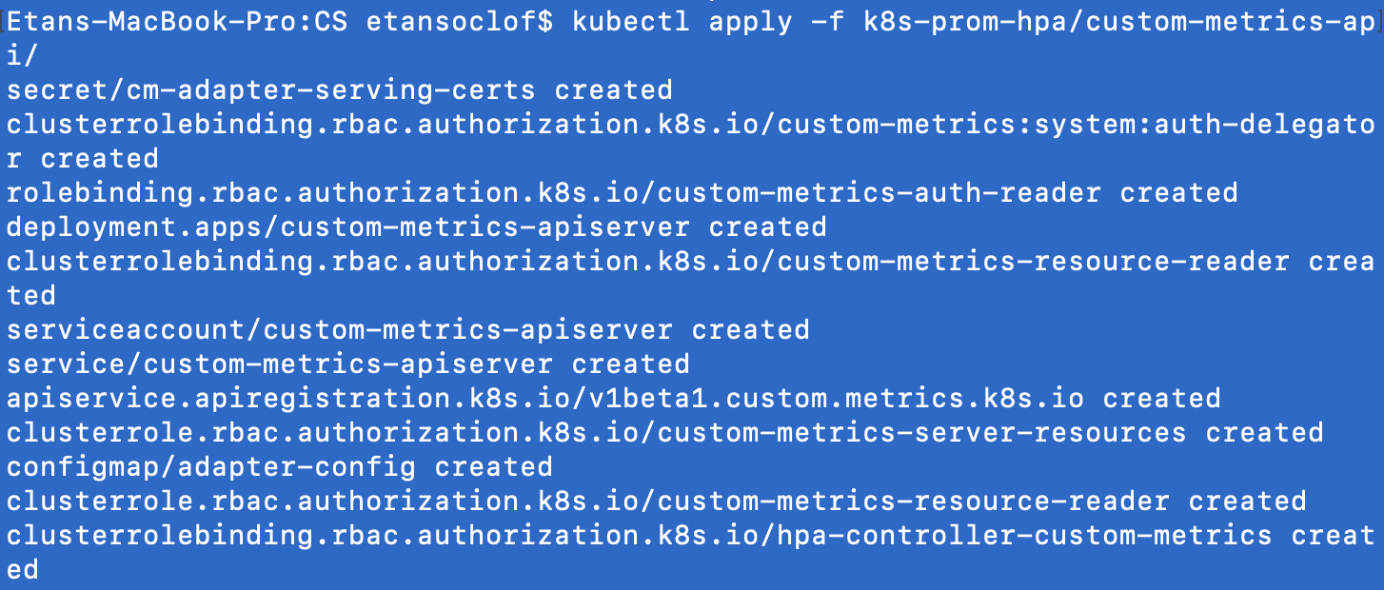
Deploy Adapter
Kubectl apply –f k8s-prom-hpa/custom-metrics-api/

Slide 27
Check Adapter
By running the following command, you should get all of the metrics integrated to the API. You can search for “requests_per_second”.
kubectl get --raw "/apis/custom.metrics.k8s.io/v1beta1" | jq .
{ "kind": "APIResourceList", "apiVersion": "v1", "groupVersion": "custom.metrics.k8s.io/v1beta1", "resources": [ ... { "name": "namespaces/requests_per_second", "singularName": "", "namespaced": false, "kind": "MetricValueList", "verbs": [ "get" ] }, ... { "name": "deployments.apps/requests_per_second", "singularName": "", "namespaced": true, "kind": "MetricValueList", "verbs": [ "get" ] }, ... ] }

Slide 28
Create Horizontal Pod Autoscaler
Next we create the HPA which uses the metric to scale
This yaml creates an hpa connected to the airmiles deployment. It has a minimum of 1 replicas and a maximum of 10.
The target is 3. This means that when the requests_per_second is more than 3, the deployment will scale. This is an Average value, meaning the total number of requests_per_second will be divided by the amount of airmiles replicas.
apiVersion: autoscaling/v2beta2 kind: HorizontalPodAutoscaler metadata: name: airmiles spec: scaleTargetRef: apiVersion: apps/v1 kind: Deployment name: airmiles minReplicas: 1 maxReplicas: 10 metrics: - type: Object object: metric: name: requests_per_second describedObject: kind: Namespace namespace: default name: default apiVersion: /v1 target: type: AverageValue averageValue: .003k

Slide 29
Deploy the hpa
Kubectl apply -f hpa.yaml --validate=false

Slide 30
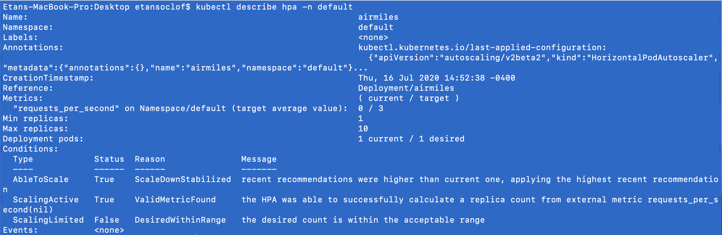
Check to see if deployed properly
Kubectl describe hpa –n default

Slide 31
Set HPA sync time
By default the HPA only check the metric once every 15 seconds. To change this, enter the following command:
minikube start --extra-config=controller-manager.HPAController.poautosclerconfig.HPAControllerConfiguration.HorizontalPodAutoscalerSyncPeriod=1s

Slide 32
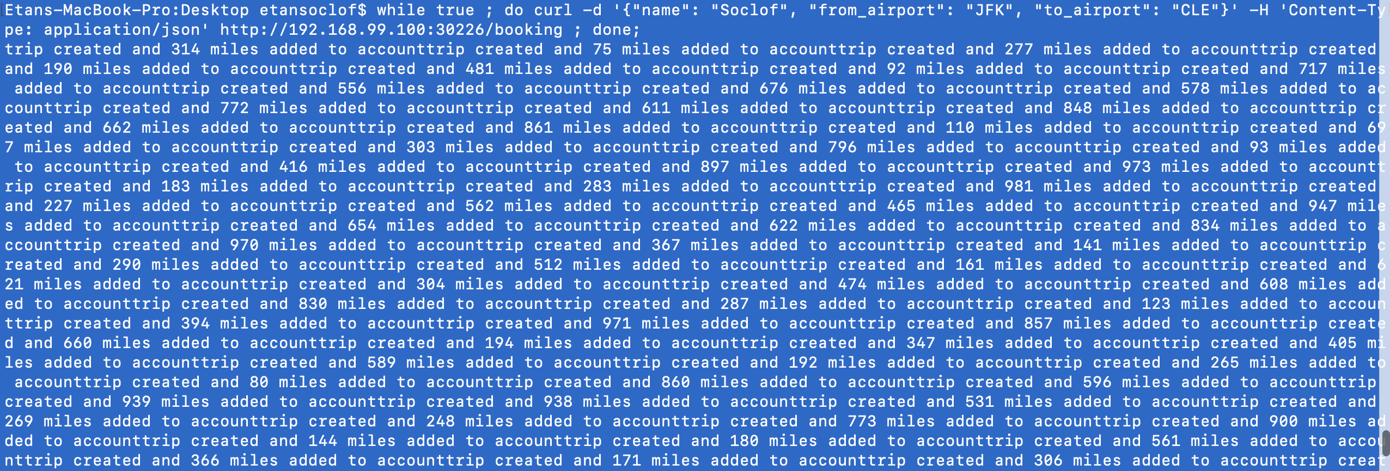
Test HPA
Set up an infinite loop to apply a load:
while true ; do curl -d '{"name": "Soclof", "from_airport": "JFK", "to_airport": "CLE"}' -H 'Content-Type: application/json' http://192.168.99.100:30226/booking ; done;
/booking ; done;

Slide 33
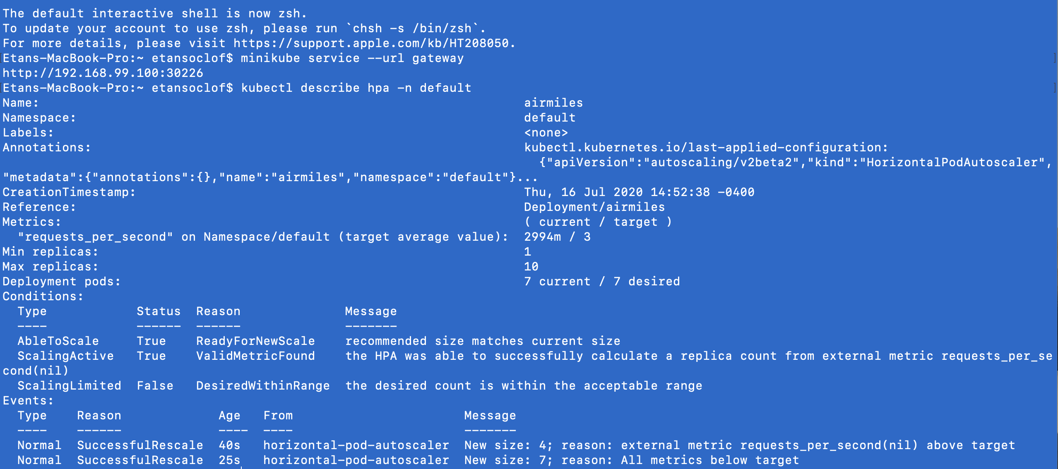

Slide 34
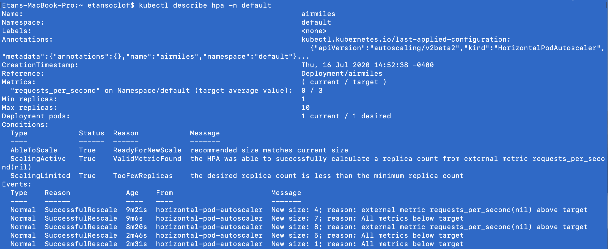
A few minutes after stopping the infinite loop, the hpa will scale in the airmiles deployment.

Slide 35
In the previous slide we see that the hpa has scaled out the airmiles deployment to 7 replicas to deal with the amount of requests being made.
Note: The amount of requests is expressed in milliunits. In the previous slide, 2994mi is equivalent to 2.994 requests per second.

Slide 36
We can add another deployment to scale at a different rate
To do this, just create a second airmiles deployment: airmiles2
Kubectl apply –f airmiles2.yaml
Create a second hpa:
kubectl apply -f hpa2.yaml --validate=false
In this hpa, the target is 5. This will scale at a slower
rate than the first hpa.
apiVersion: autoscaling/v2beta2 kind: HorizontalPodAutoscaler metadata: name: airmiles2 namespace: default spec: scaleTargetRef: apiVersion: apps/v1 kind: Deployment name: airmiles2 minReplicas: 1 maxReplicas: 10 metrics: - type: Object object: metric: name: requests_per_second describedObject: kind: Namespace namespace: default name: default apiVersion: /v1 target: type: AverageValue averageValue: .005k

Slide 37
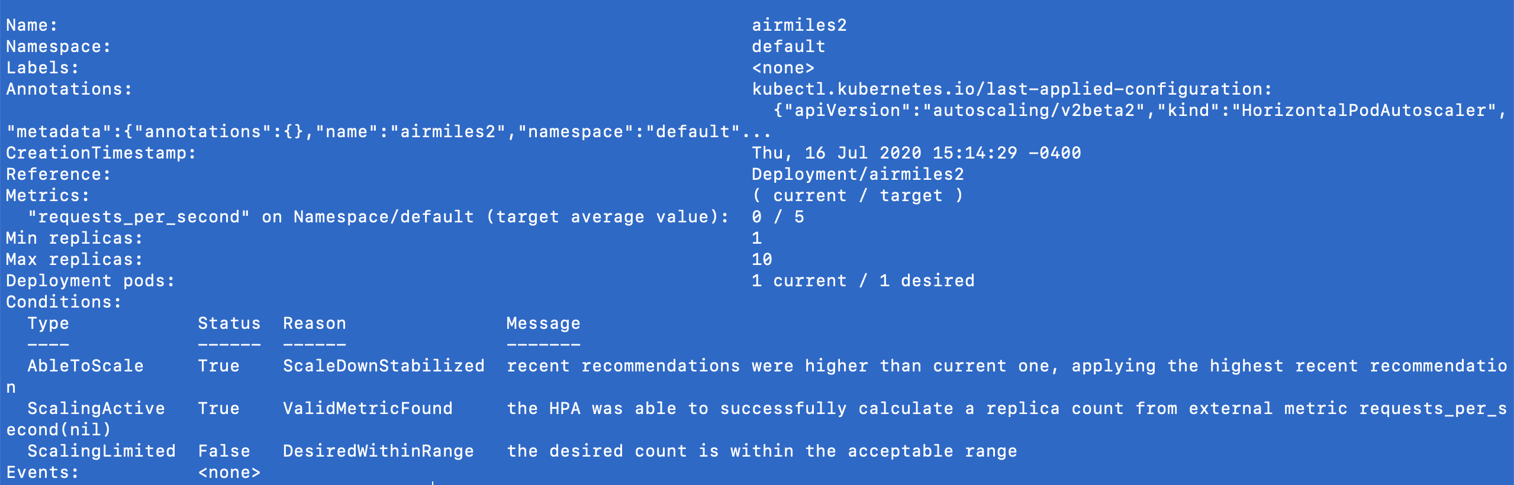
Kubectl describe hpa --n default
It now returns both hpas. This is the second hpa

Slide 38
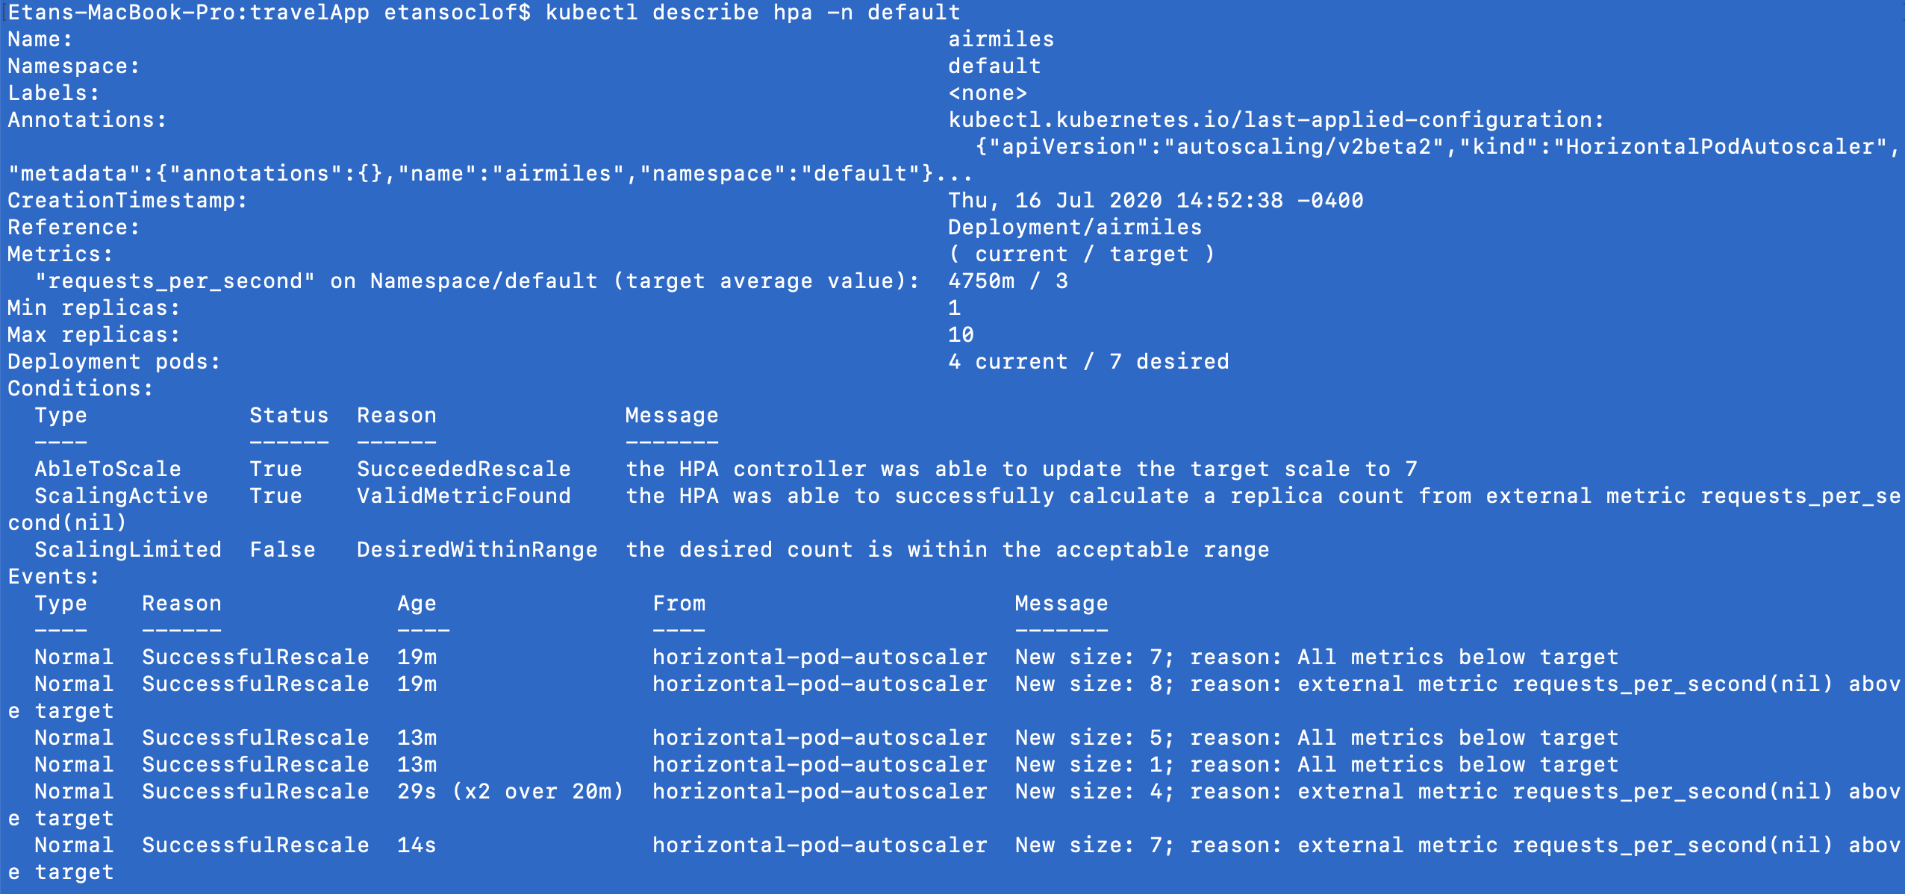
Once we start the infinite loop, we see that the first hpa sclaes out to 7 to compensate for the amount of requests.

Slide 39
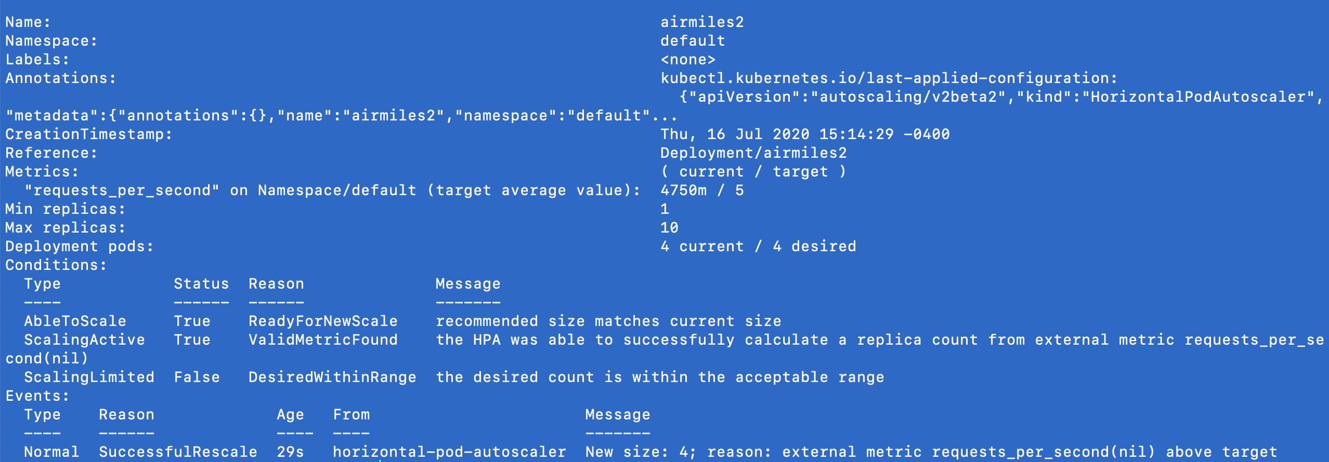
The second hpa only scales to 4.

